Slide 1
PROGRAM LEADERSHIP CASE STUDY
Workforce Stability Among
Post-9/11 Veterans
An integrated evidence program built across federal data sources — ACS PUMS, BLS LAUS, BEA Regional, VA NCVAS — under Six Sigma DMAIC and military After-Action Review discipline.
Patrick Neil Bradley
Founder, Legends' Return Foundation · Program Manager
Charter v1.0 · Kickoff 2026-04-16 · Build v0.16

Slide 2
EXECUTIVE SUMMARY
A founder-operated R&D program, chartered to build defensible evidence on veteran workforce stability.
DATA SOURCES INTEGRATED
POST-9/11 COHORT ROWS
BUILD ITERATIONS
PUBLIC ARTIFACTS
4
184k
v0.1 → v0.16
5
ACS · BLS · BEA · VA
2019, 2021, 2022, 2023
26 days; build-log discipline
Case study · Model card · Explorer · Charter · AAR
Mission delivered.
Four federal data sources integrated into a single state-year analytic panel. Cohort funnel documented row-by-row. An illustrative logit retention model published with a transparent model card disclosing a synthetic-target ceiling. Case study, model card, and interactive explorer live on PatrickNeilBradley.com — all reproducible from a single config and a public build log.
Workforce Stability Program · Patrick Neil Bradley · Slide 2 of 14

Slide 3
CHAPTER 01 · PROBLEM & MISSION
Commander's Intent
THE PROBLEM
THE MISSION
Post-9/11 veterans separate into a labor market that inconsistently translates military experience into stable civilian employment.
Federal data exists — ACS PUMS, BLS LAUS, BEA Regional, VA NCVAS — but is rarely integrated into a single analytical view that policymakers, employer coalitions, and veteran-services organizations can act on.
Produce an integrated, reproducible analytical evidence base describing post-9/11 veteran workforce stability across geography, disability, occupation, and time — and publish it under a methodology any qualified analyst can audit.
End state: a public case study, a reusable pipeline, an illustrative retention model with a transparent model card, and an interactive explorer — delivered to a standard that withstands scrutiny from a federal program office, an employer coalition, or an academic reviewer.
Workforce Stability Program · Patrick Neil Bradley · Slide 3 of 14

Slide 4
CHAPTER 02 · OBJECTIVES
Five objectives, each with an auditable success criterion.
01
Integrate four federal data sources at PUMA/state/sector level
✓
Success: All four sources joined, validated, and version-controlled by v0.10
02
Characterize the post-9/11 cohort on geography, disability, and labor-force outcomes
✓
Success: Reproducible cohort funnel with row-count tolerances at every step
03
Build an illustrative retention model with a transparent ceiling
✓
Success: Model card with AUC, calibration, limitations, and §4a on synthetic-target effects
04
Publish a case study, model card, and interactive explorer
✓
Success: All three artifacts live on PatrickNeilBradley.com with build-log references
05
Maintain build discipline across the program
✓
Success: Build log appended for every ingest, join, and model refit
Workforce Stability Program · Patrick Neil Bradley · Slide 4 of 14

Slide 5
CHAPTER 03 · SCOPE
What this program does — and what it deliberately does not.
IN-SCOPE
OUT-OF-SCOPE
ACS PUMS 2019, 2021, 2022, 2023 (2020 unavailable — COVID)
BLS LAUS, BEA Regional, VA NCVAS as joinable context
Post-9/11 cohort: MLPA = 1, ages 22–64, U.S. states + DC
O*NET Work Context composites (Phase 6 add)
Illustrative logit retention model with O*NET composites
Public case study, model card, and interactive explorer
Pre-9/11 era veterans (descriptive only, not modeled)
Active-duty service members (filtered via ESR codes)
Causal inference on policy interventions
Individual-level identification or PII (public microdata only)
Predictions about any named employer
Workforce Stability Program · Patrick Neil Bradley · Slide 5 of 14

Slide 6
CHAPTER 04 · STAKEHOLDERS & GOVERNANCE
Five stakeholders. One governance rhythm.
STAKEHOLDERS
GOVERNANCE CADENCE
Legends' Return Foundation
DAILY
Sponsor (founder-operated, DV-owned LLC)
Build-log entry for every ingest, join, or refit
Post-9/11 veterans
End beneficiaries (lived-experience reviewer)
WEEKLY
Program Manager review: risks, AUC trajectory, blockers
Veteran services orgs
Downstream consumers of findings
PHASE GATE
Employer coalitions
Documented decision log with rationale
Hiring and retention insight
CLOSE
Federal data stewards
Formal After-Action Review
Source integrity, citation, public-use terms
Workforce Stability Program · Patrick Neil Bradley · Slide 6 of 14

Slide 7
CHAPTER 05 · PHASE PLAN
From scaffold to v0.16 in twenty-six days.
Phase 1
Phase 2
Phase 3
Phase 4
Phase 5
Phase 6
Phase 7
Phase 8
Scaffold + ACS PUMS ingest
Full ACS pull (all years/states)
BLS / BEA / VA joins
Modeling prep, baseline logit
Model card + case study draft
O*NET composites (v0.16)
Tier-2 SOC crosswalk
Public launch + blog
Apr 16
Apr 16
Apr 17
Apr 18
Apr 19
Apr 20
Blocked
Pending
Complete
Blocked (Tier-2 SOC access)
Pending
Phase 7 is intentionally deferred, not cancelled. The Tier-2 OCCP → 8-digit SOC crosswalk is required for clean composite identification but is blocked outside the program's allowlist. Documented as a known constraint in the model card and the AAR.
Workforce Stability Program · Patrick Neil Bradley · Slide 7 of 14

Slide 8
CHAPTER 06 · DATA ARCHITECTURE
Four public sources. One state-year analytic panel.
ACS PUMS
BLS LAUS
BEA Regional
VA NCVAS
American Community Survey microdata
Local Area Unemployment Statistics
Regional Economic Accounts
Veterans Analysis & Statistics
Veteran cohort, demographics, disability, occupation
State labor-market context, monthly + annual
State income (SAINC1) and GDP (SAGDP2) context
Disability ratings, VR&E, vet population by state
▼
STATE × YEAR ANALYTIC PANEL
184k post-9/11 veteran rows × 51 states × 4 years
Cohort-attached features + state-year context + O*NET work-context composites
Joins, missing-data rules, and synthetic-outcome construction are versioned in join_layer_spec.md and reproducible from the public build log.
Workforce Stability Program · Patrick Neil Bradley · Slide 8 of 14

Slide 9
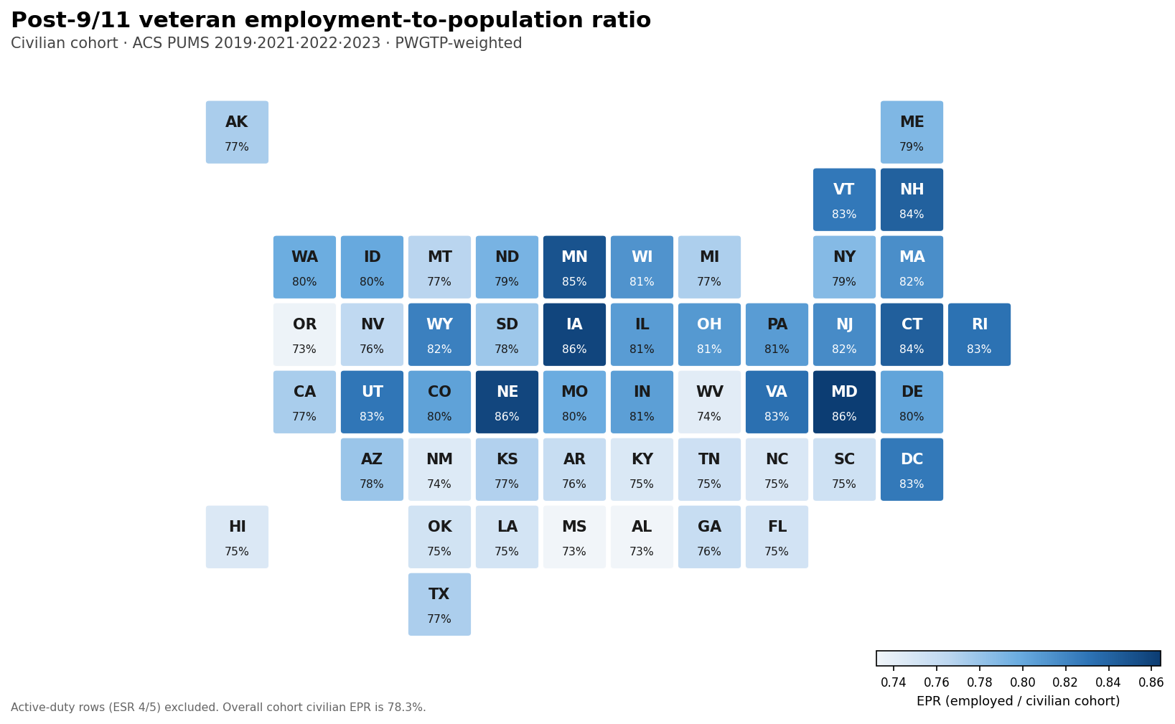
CHAPTER 07 · RESULT 01
Employment-population ratio varies sharply across states.
READ-OUT
Post-9/11 veterans show meaningful state-to-state variation in employment-population ratio — a stability signal the model uses as an anchor variable.
WHY IT MATTERS
Geographic dispersion is one of the few signals that survives the synthetic-target ceiling discussed in Chapter 9.
Workforce Stability Program · Patrick Neil Bradley · Slide 9 of 14

Slide 10
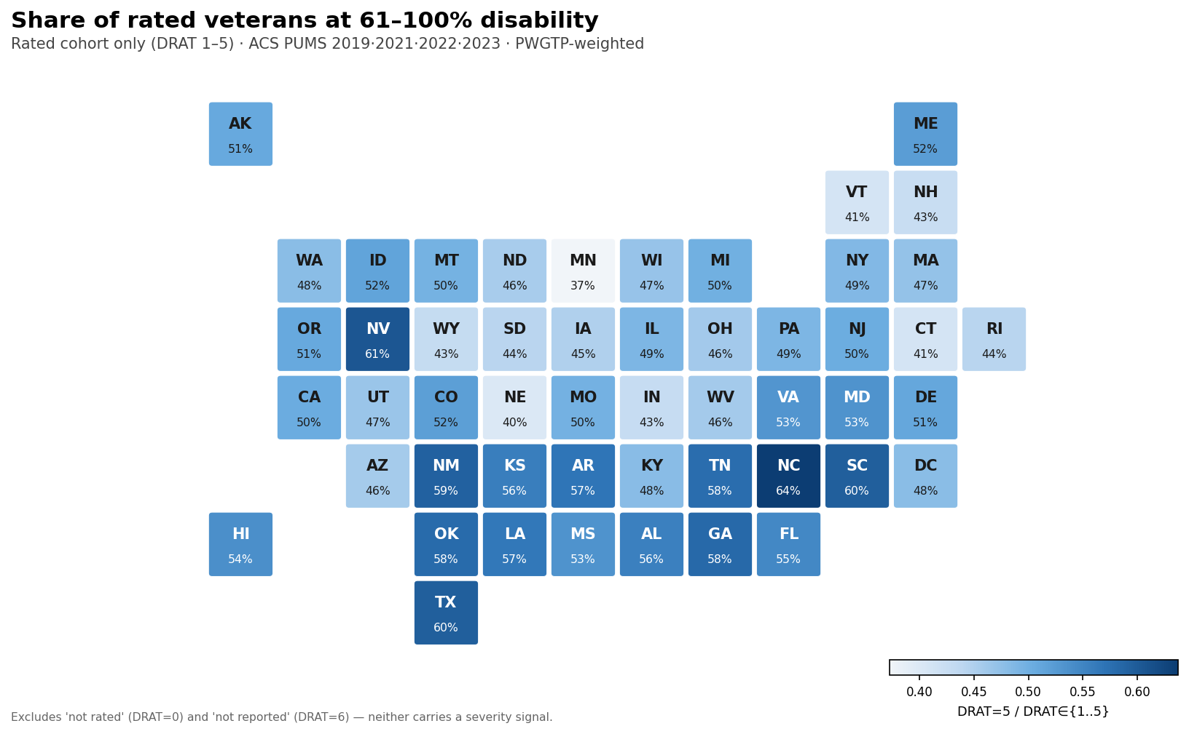
CHAPTER 07 · RESULT 02
Severe disability rating concentration is geographically uneven.
READ-OUT
Severe service-connected disability share (DRAT) clusters in certain states — a function of base presence, post-service migration, and VA enrollment intensity.
POLICY USE
Employer coalitions in concentration states can target workplace accommodations and VR&E partnerships with the highest expected return.
Workforce Stability Program · Patrick Neil Bradley · Slide 10 of 14

Slide 11
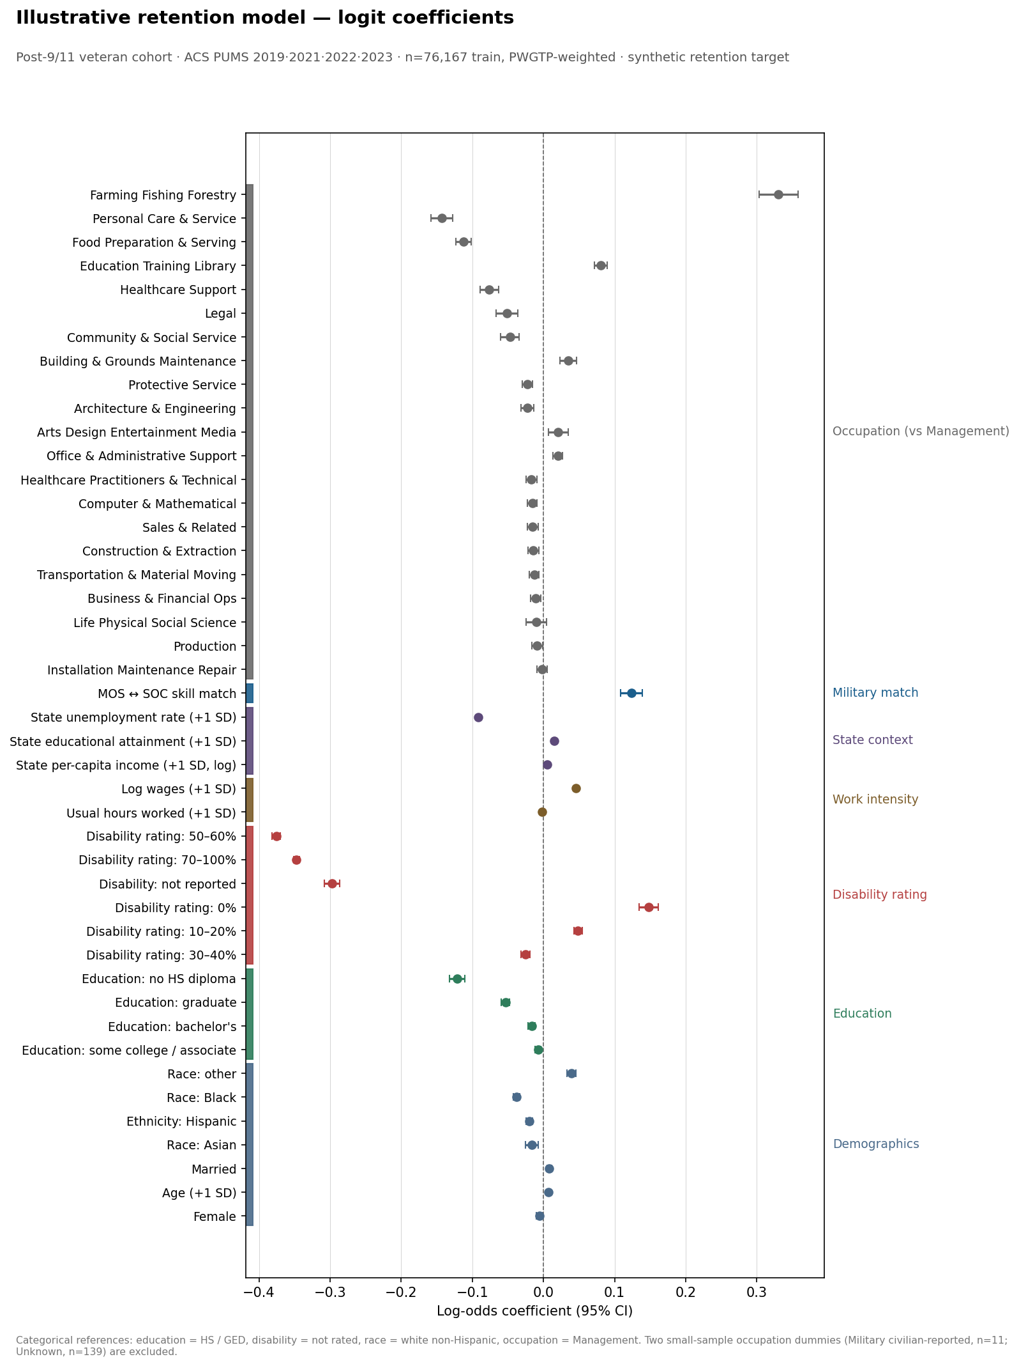
CHAPTER 08 · MODELING
Feature importance, with a transparent ceiling.
AUC HONESTY
Test AUC: 0.566
Validation AUC: 0.561
Flat by design.
The retention outcome is synthetic — built from cross-sectional ACS panels rather than observed longitudinal transitions. The model card §4a discloses this ceiling openly. Feature importances remain interpretable; predicted probabilities are illustrative only.
Workforce Stability Program · Patrick Neil Bradley · Slide 11 of 14

Slide 12
CHAPTER 09 · RISK MANAGEMENT
Five risks. Each mitigated explicitly.
ID
RISK
LIKELIHOOD
IMPACT
MITIGATION
R1
Synthetic retention outcome read as a real prediction
Med
High
Model card §4a; case-study language emphasizes "illustrative" throughout
R2
Tier-2 OCCP crosswalk unavailable; composites collinear with SOC dummies
High
Med
Document collinearity; Phase 7 deferred, not cancelled
R3
Sandbox API restrictions block reproducibility for outside reviewers
Med
Med
Pipeline runs cleanly on local Python; .env template documented
R4
Brand inconsistency across case study, model card, and explorer
Med
Low
Single design spec; consolidation pass scheduled
R5
Reviewer questions lived-experience legitimacy of cohort framing
Low
Med
Lived-experience reviewer: Army 11C, post-9/11 — is the PM
Workforce Stability Program · Patrick Neil Bradley · Slide 12 of 14

Slide 13
CHAPTER 10 · AFTER-ACTION REVIEW
What I'd do differently — preview of the formal AAR.
SUSTAINS
IMPROVES
Daily build-log discipline — every ingest, join, and refit auditable
Synthetic-target honesty disclosed at charter, not after results
Founder-operator framing — disclosed openly, not obscured
Versioned phase plan: v0.1 → v0.16 in 26 days without scope drift
Lived-experience review embedded in the PM role, not a sign-off
Secure Tier-2 SOC crosswalk before Phase 4 — not after Phase 6
Build the AAR PDF in parallel with the model card, not after
Standardize brand styling across case study, model card, explorer earlier
Time-box exploratory figures — Phase 4a yielded 30; 8 was enough
Stage the deck as an artifact from kickoff, not as a retrospective add
Workforce Stability Program · Patrick Neil Bradley · Slide 13 of 14

Slide 14
PROGRAM LEADERSHIP IN PRACTICE
Mission, command, evidence,
after-action.
This program demonstrates the operating discipline I bring to every project I run: a clear commander's intent, a chartered scope, an evidence-based execution loop, transparent risk management, and a formal After-Action Review at close. Methodology base: Six Sigma DMAIC, military AAR, and mission-command leadership translated to civilian execution.
ARTIFACTS
Case study · Model card · Interactive explorer · Project Charter · Risk Register · AAR
CONTACT
patrick@patrickneilbradley.com · PatrickNeilBradley.com

